Slide 1
Diabetes Dashboard

Slide 2
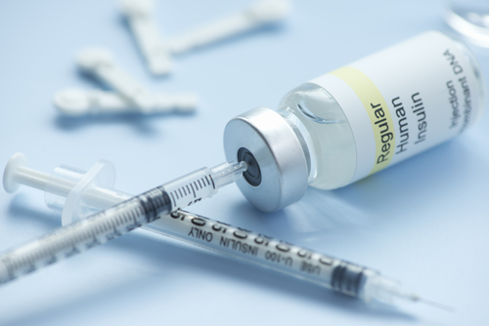
We closely manage the care of our pediatric patients with Type 1 or Type 2 diabetes.
Insulin as a treatment:
  Internationally recognized as high risk and potentially lethal med.
  Requires a complex therapy regime, with dosage amounts personalized to patient and varying throughout day.

Slide 3


Diabetes Dashboard – an EHR application
Increased efficiency for providers
A comprehensive view eliminates need to scroll through the EHR, saving providers time and effort.
Pulls lab results most relevant to diabetes care
Provides longitudinal view of patient blood glucoses from multiple data sources
Provides medication orders by insulin type
Improved safety for patients
With development by diabetes experts and front-end users, the application aligns with our culture of safety.
Features an easy-to-use insulin dosage calculator for blood glucose correction & carbohydrates, customized with input values specific to patient

Slide 4
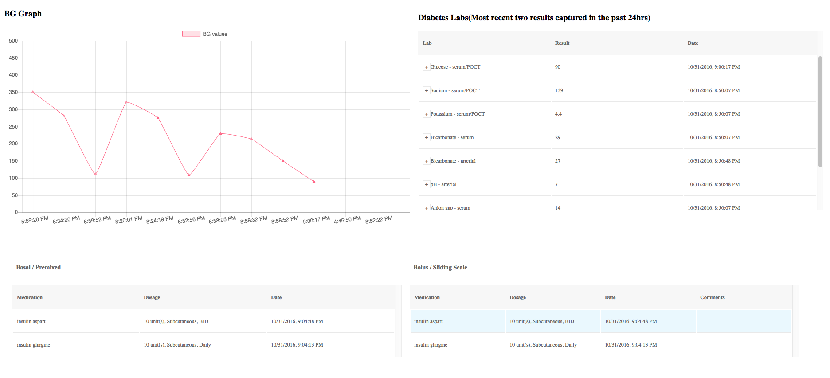
Diabetes Dashboard – Overview
Three major components help providers ensure and manage the safety of inpatients with diabetes.
Blood glucose graph
Diabetes labs
Insulin medication orders

Slide 5
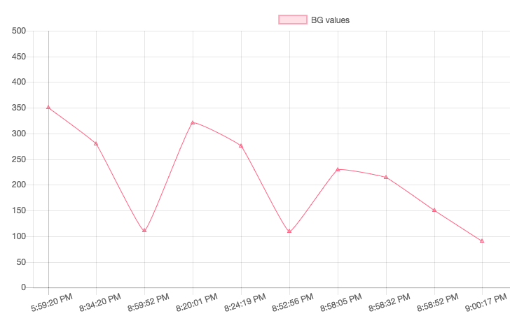
Blood Glucose (BG) Graph
Displayed in timeline format, overlaid with blood glucose graph collected from multiple sources.

Slide 6
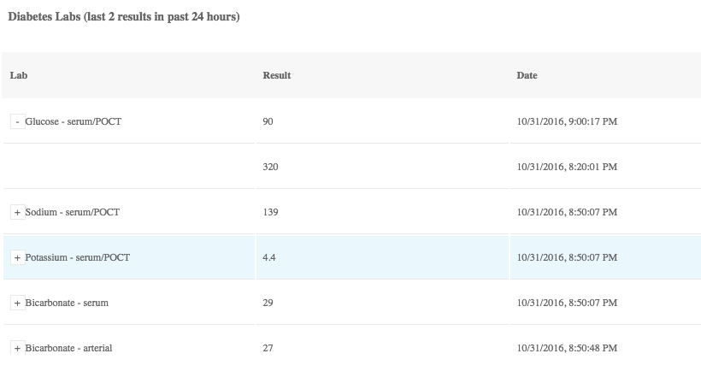
Diabetes Labs
  Component allows for relevant POCT + Lab to be visible all in one place.

Slide 7
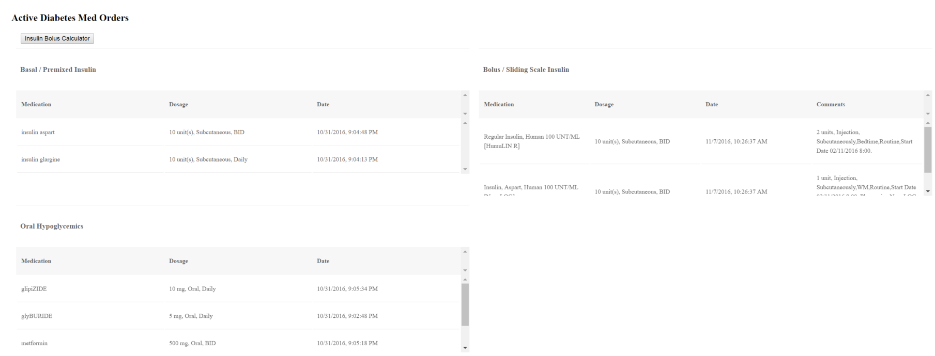
Insulin Therapy View
Proprietary algorithm filters medication orders and categorizes the orders into Basal, Bolus, and Oral Hypoglycemics sections.

Slide 8
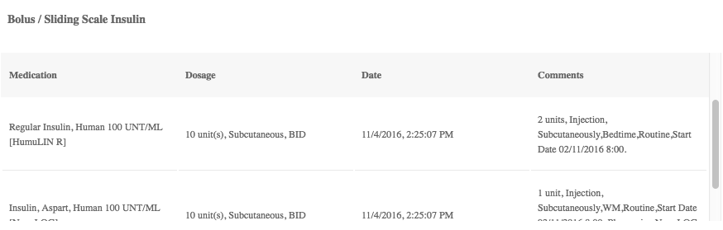
Basal/Premixed
Component displays long-acting insulin orders.

Slide 9
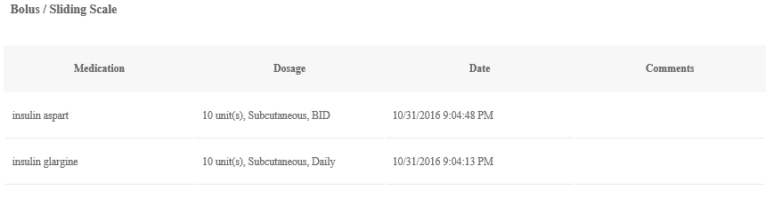
Bolus/ Sliding Scale
Component displays fast-acting insulin.

Slide 10
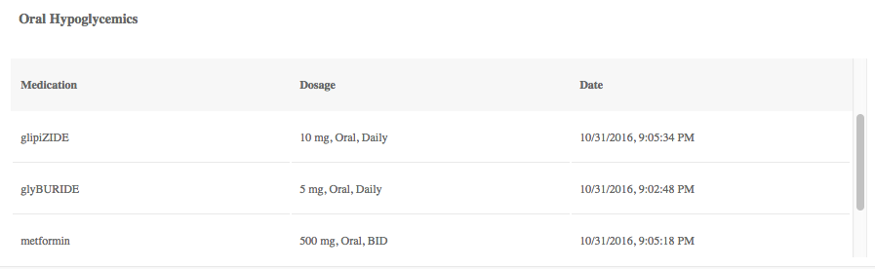
Oral Hypoglycemics
Component displays oral hypoglycemic drugs ordered, along with dosage amount, date and time.

Slide 11
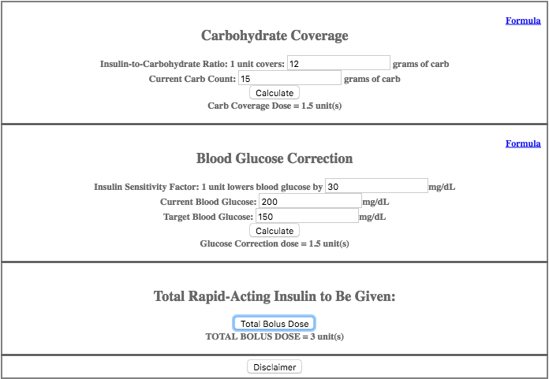
Insulin Bolus Calculator
An easy to use insulin dosage calculator.

